Slide 1

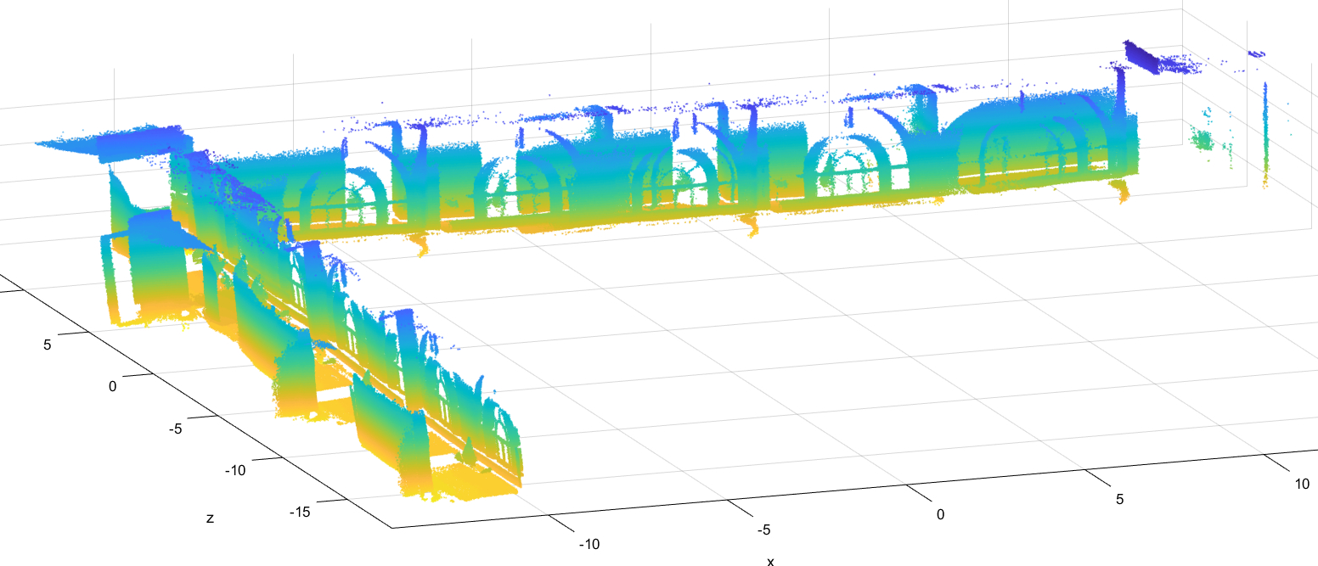
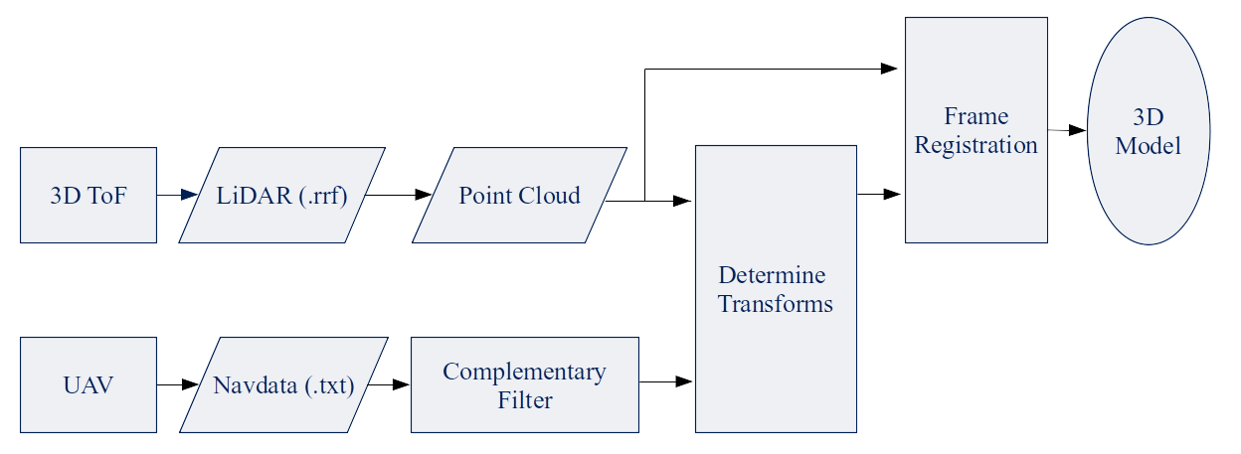
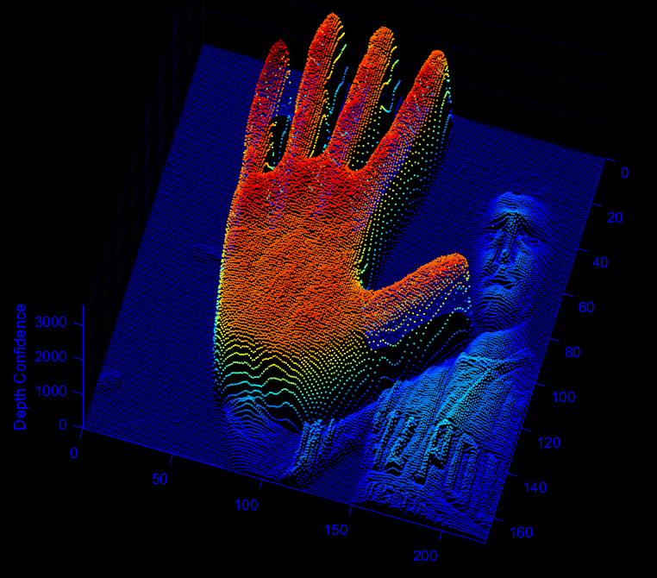
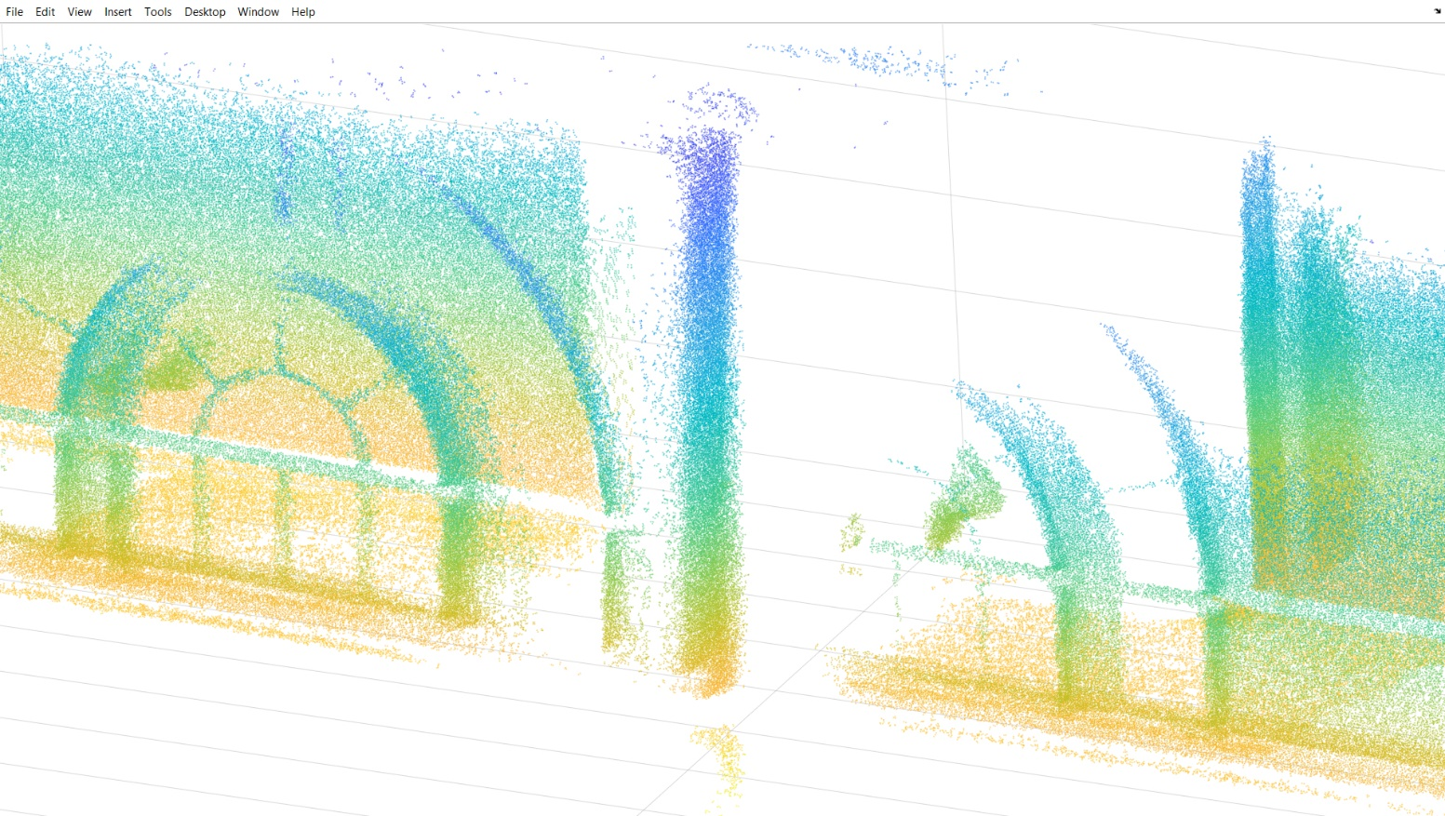
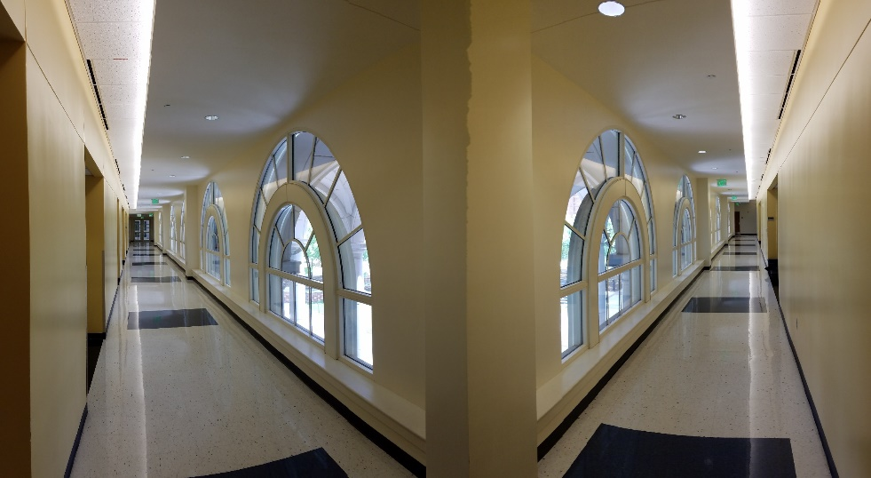
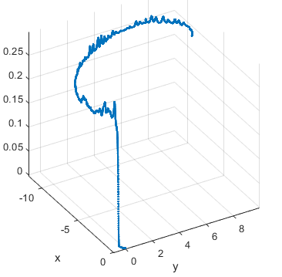
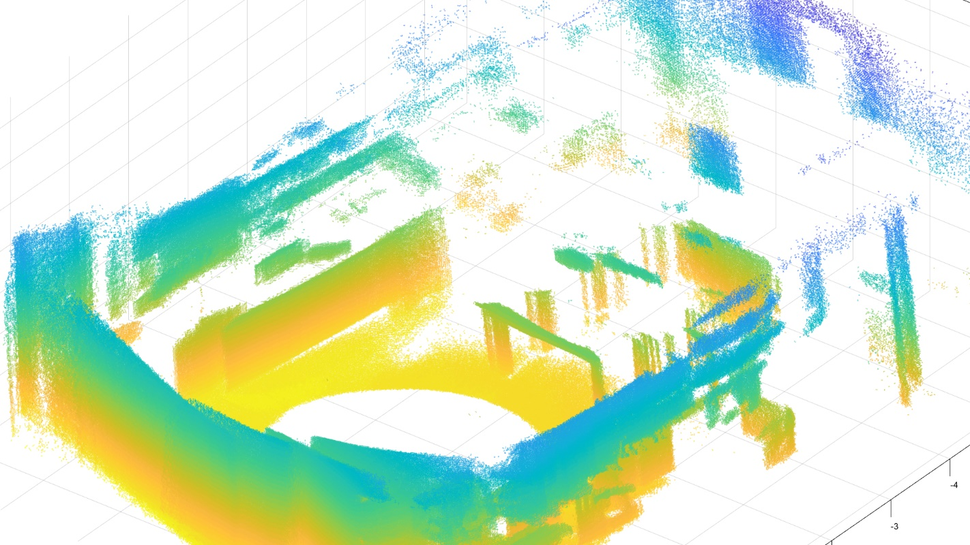
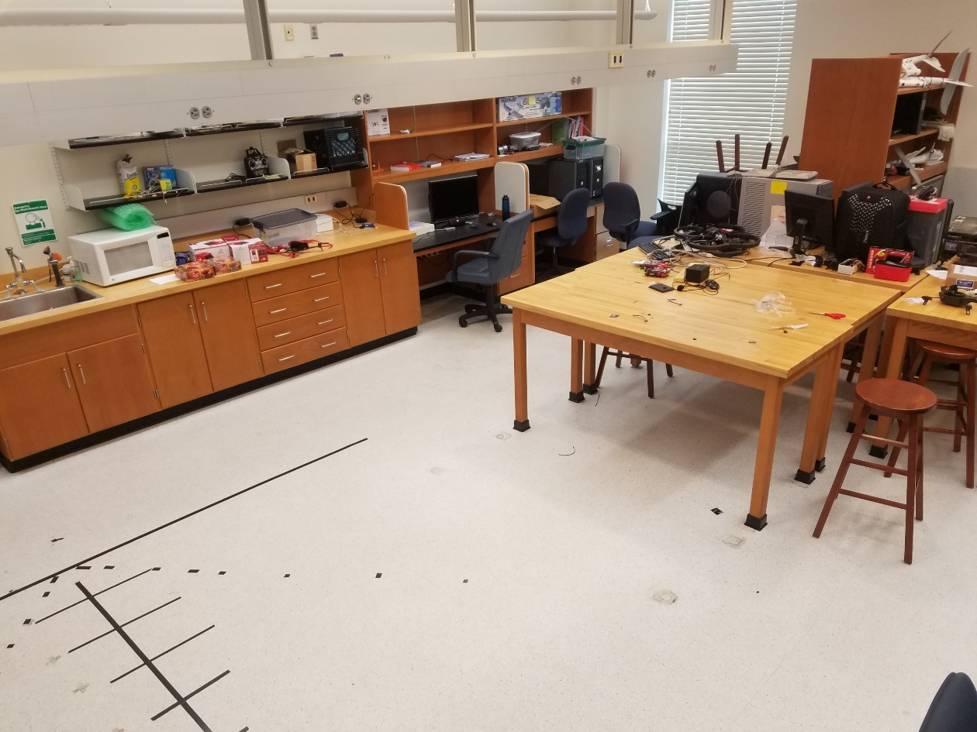
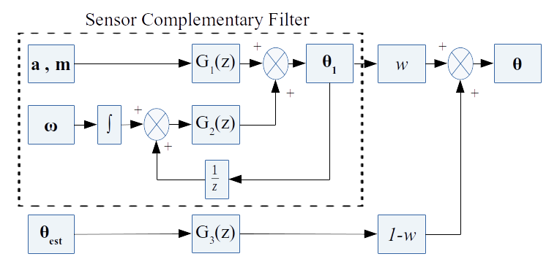


UAV SLAM and Interior Modeling with 3D LiDAR in GNSS-Denied Environments
Conor Green and Brenden Stevens
Dr. Richard Chapman and Dr. Saad Biaz
Auburn University
INTRODUCTION
METHODS (cont.)
RESULTS (cont.)
Small, quadrotor helicopter, or quadcopter, unmanned aerial vehicles (UAVs) have unique abilities to map environments, particularly utilizing 3D flash light detection and radar (LiDAR) technologies. However, the majority of applications to date use global navigation satellite systems (GNSS) to determine location in order to register together LiDAR frames, which is unavailable inside many buildings. The project presented equipped a quadcopter UAV with a recently developed 3D LiDAR sensor and manually navigated through an interior environment to provide navigation and point cloud data to create extensive and accurate models of the interior of a building in constrained circumstances
determining the movement between each frame, providing an initial seed as to how each frame is positioned relative to the first frame. All frames can be merged and rendered into a clean, 3D model of the environment traversed. A flowchart of the total process is given in Fig. 3.
TECHNOLOGIES
Flash LiDAR:
Otherwise called a 3D time of flight (ToF) camera, a flash light detection and ranging (LiDAR) camera emits light over a two-dimensional area, similar to a camera, and returns the distance to each pixel, as demonstrated in Fig. 1.
UAVs and Pose Estimation:
Small, quadcopter unmanned aerial vehicles (UAVs) provide a unique opportunity to video interiors with
(a) LiDAR Model of Hallway
Figure 3: Data and Processes Flowchart
RESULTS
Pose Estimation:
Pose was estimated with poor accuracy through complementary filtering. A flight path is illustrated in Fig. 4.
LiDAR Mapping:
In situations with less planes/flat surfaces, the transforms derived from navigation data proved more accurate. A 360º scan of the workspace was taken by rotating the UAV and flash LiDAR on a chair. The LiDAR scan and navigation data was weighted more towards the navigation data transforms. The resultant 3D model and a camera image of the
Figure 1: Flash LiDAR Frame
lightweight cameras. Often, the Global Navigation Satellite System (GNSS) is used to track the location of a UAV and to localize without GNSS is a difficult problem.
(b) LiDAR Model of Hallway Magnified View
(c) Camera Photo of Hallway
OBJECTIVES
Figure 6: Translational LiDAR Model with Corresponding Photo
Perform UAV localization without GNSS and utilize pose estimations to determine the transformations between each frame
Use iterative point cloud (ICP) algorithms to determine a separate estimate of the transformations between each frame
Register LiDAR frames into a single 3D model using aforementioned transforms
CONCLUSIONS
Final Points:
Registering a sequence of LiDAR frames into a single comprehensive model was demonstrated to be viable. The estimation of pose without GNSS was accurate in estimating attitude but inaccurate in estimating position. ICP algorithms were able to supplement this inaccuracy in situations with large flat surfaces. Despite reasonable results when the UAV was carted, flying with a 3D ToF camera and SBC did not return a good model.
Future Work:
The project still clearly demonstrates the efficacy of LiDAR mapping and provides justification for further research and development in the area. Improved position estimation through a Kalman filter may yield more accurate estimations. Furthermore, kerneling techniques on the point cloud data could significantly improve the transform estimations from the point cloud [3].
Figure 4: Example Position Estimation of Flight
workspace are given in Fig. 5(a)(b). Using ICP techniques to determine transforms was significantly more accurate compared to navigation data in scans with many flat surfaces, especially considering the pose estimation is prone to bias over long distances (e.g. 40m hallway.) A scan of the hallway was taken by putting the UAV on a rolling chair and carting it down the hallway. The point cloud was rendered by putting more weight on the ICP transforms. The resultant model is given in Fig. 6(a-c).
METHODS
In order to achieve a 3D model, two technologies, the flash LiDAR and a UAV were manually navigated through the interior of a building. The processing was done in post in MATLAB on desktop/laptop computers. The navigation data was put through a complementary filter to provide relatively accurate estimations of pose [1][2]. A complementary filter achieves sensor fusion between short and long term stable readings while maintaining physical relevance as described in Fig. 2.
The LiDAR data frames were converted into point clouds using MATLAB and then fed through the ICP algorithm. When combined with pose estimations, ICP is highly accurate in
REFERENCES
[1] Armando Alves Neto, Douglas Guimaraes Macharet, Victor Costa da Silva Campos, and Mario Fernando
Montenegro Campos. Adaptive complementary filtering algorithm for mobile robot localization.
[2] Antonio Vasilijevic, Bruno Borovic, and Zoran Vukic. Underwater vehicle localization with complementary filter: Performance analysis in the shallow water environment. Springer Science+Business Media, August 2012.
[3] Y. Tsin and T. Kanade, “A Correlation-Based Approach to Robust Point Set Registration,” Proc. European Conf. Computer Vision, pp. 558-569, 2004.
(a) LiDAR Model of Laboratory
(b) Camera Photo of Laboratory
Figure 5: Rotational LiDAR Model with Corresponding Photo
The LiDAR flash camera was fixed to the quadcopter and flown down the same hallway as given in Fig. 6(a-c); however, the resultant 3D model was erroneous. Implementing LiDAR onto a small quadcopter is a physical challenge and is detrimental to the maneuvering ability of the UAV; thus, reducing LiDAR video quality.
ACKNOWLEDGEMENTS
Figure 2: AHRS Complementary Filter System Diagram
National Science Foundation – REU Programs
Department of Defense – Funding
Auburn University – Program Host

